Slide 1
Introduction to Artificial Intelligence(AI)
@Shravankumar147

Slide 2
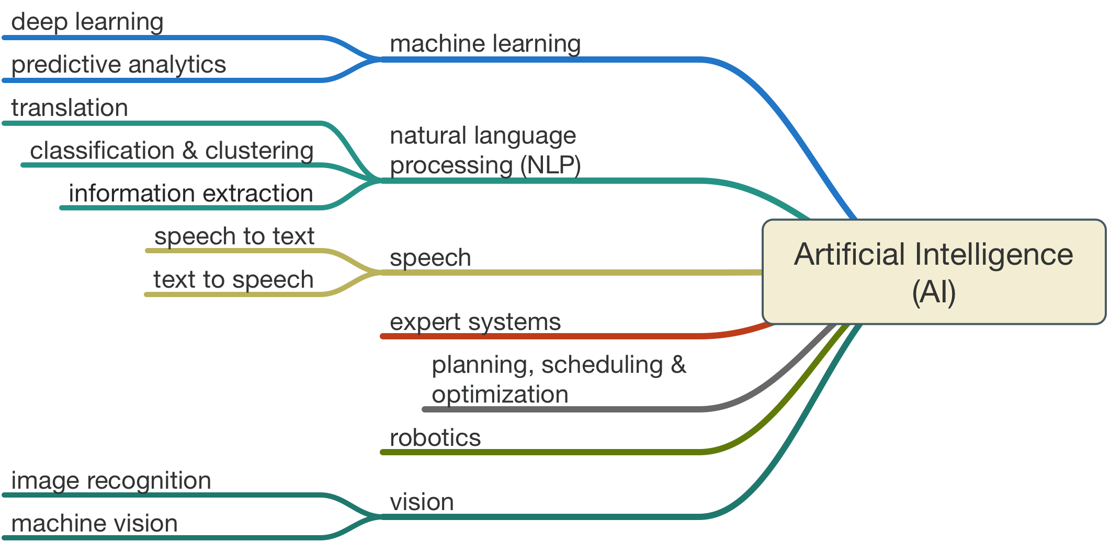
Notes:
It is the science and engineering of making intelligent machines, especially intelligent computer programs. It is related to the similar task of using computers to understand human intelligence, but AI does not have to confine itself to methods that are biologically observable.

Slide 3
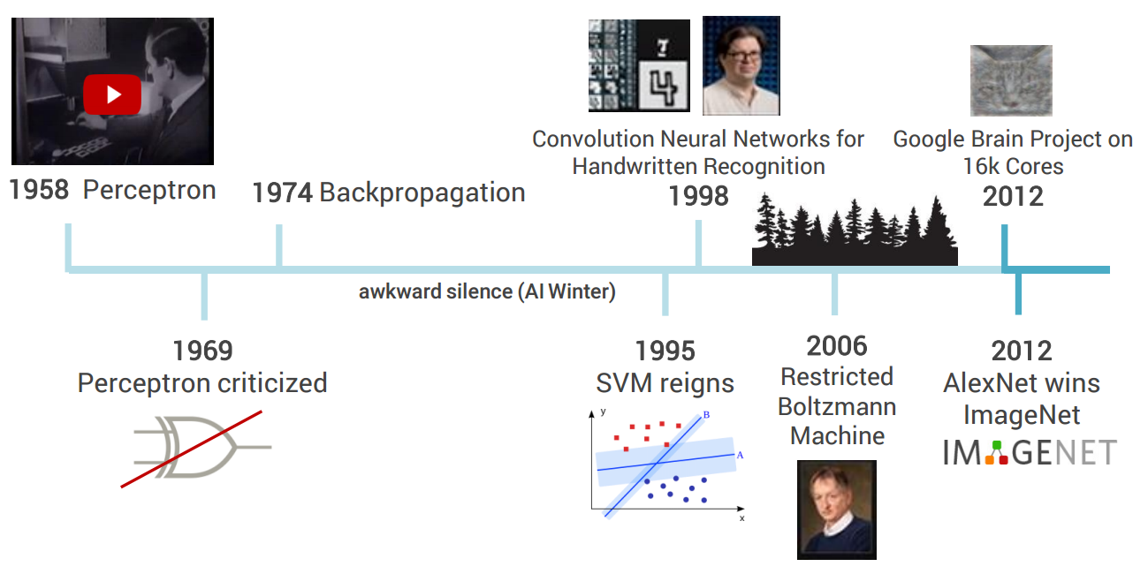
Why it is so popular now?
Notes:
http://www-formal.stanford.edu/jmc/whatisai/whatisai.html

Slide 4
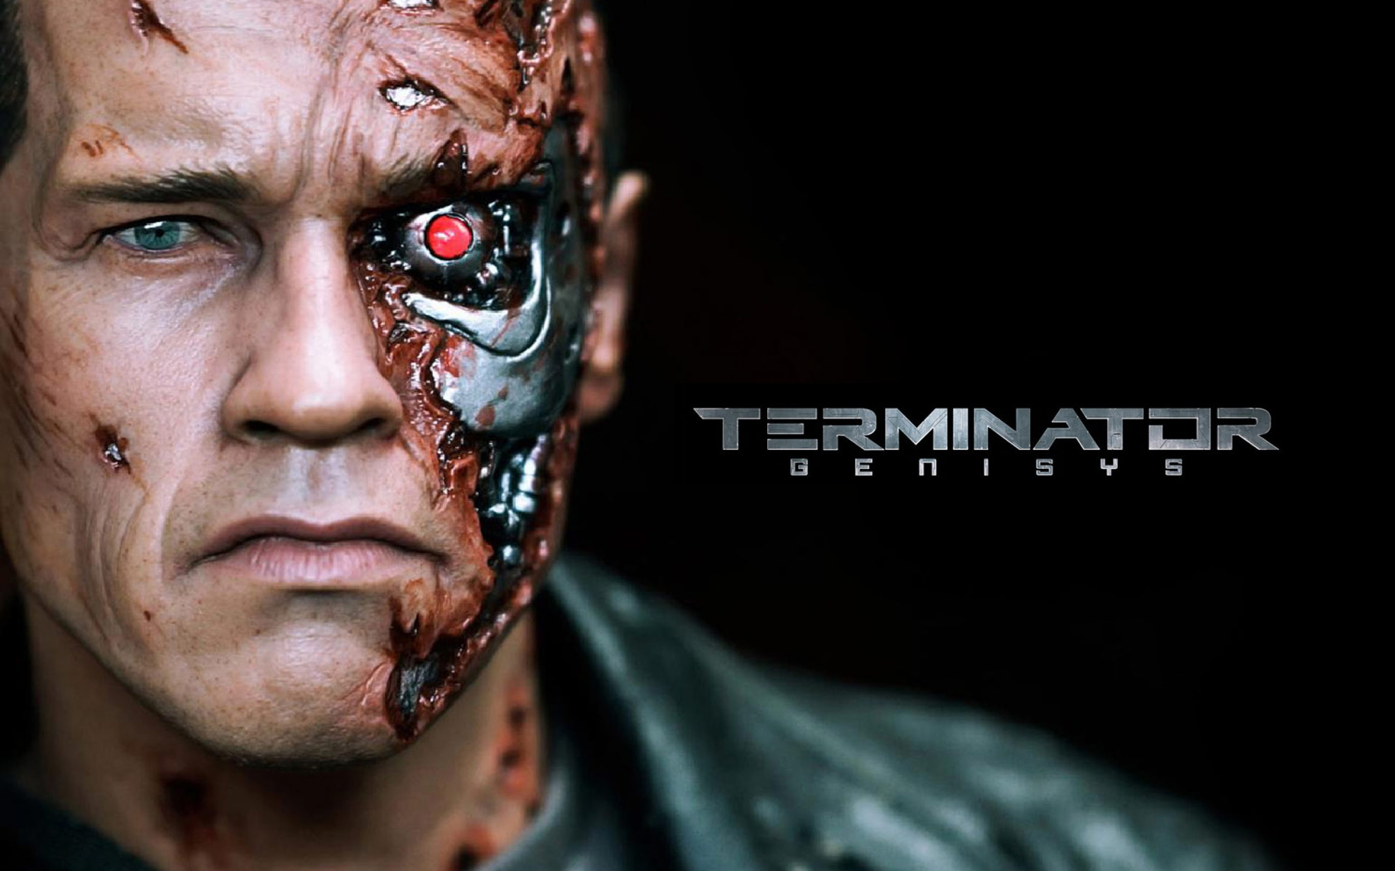

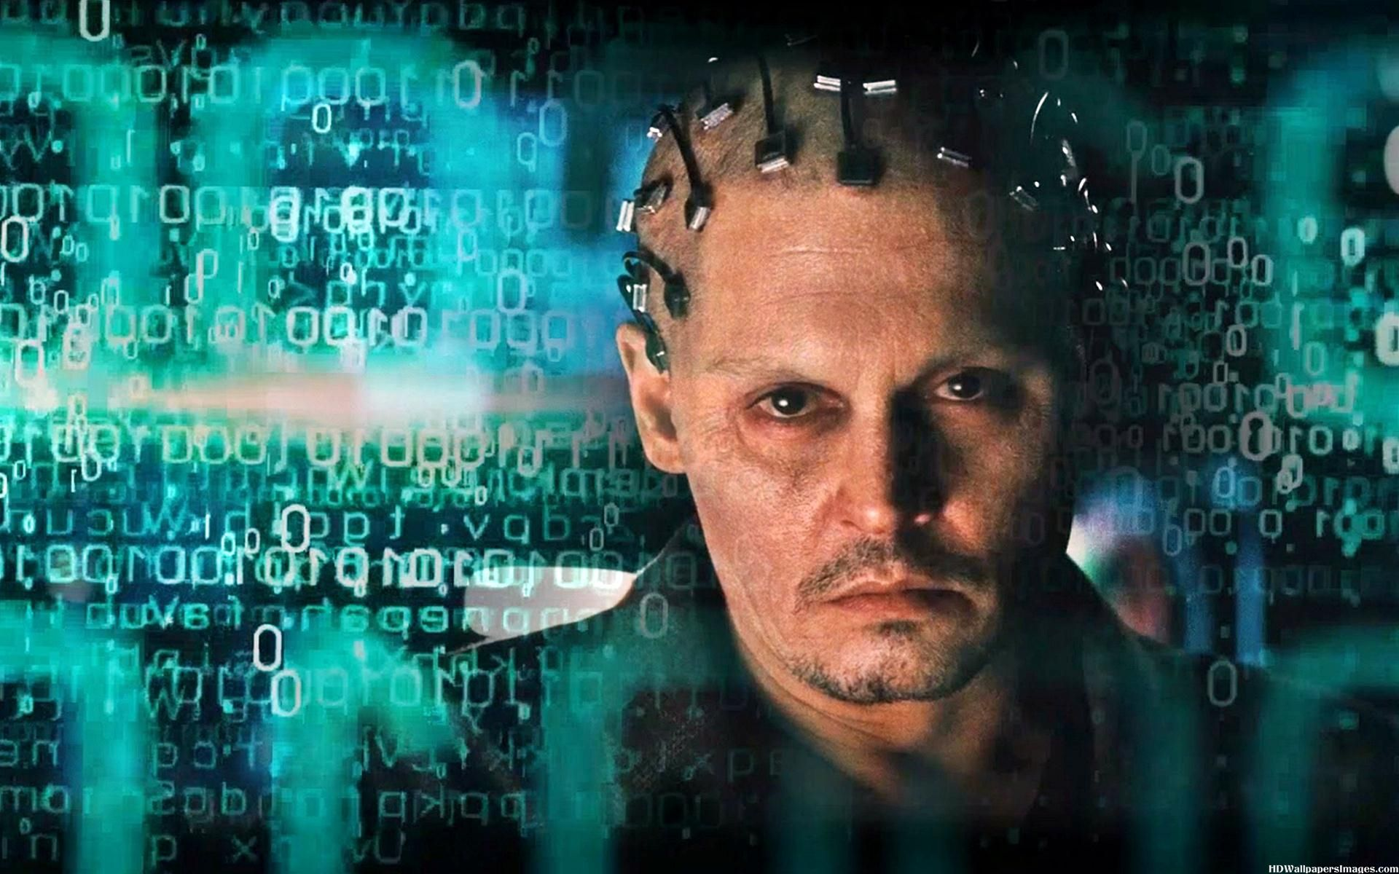

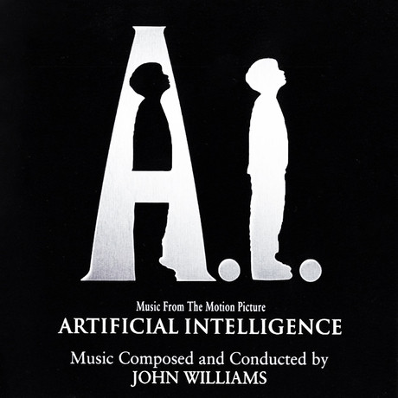


Slide 5
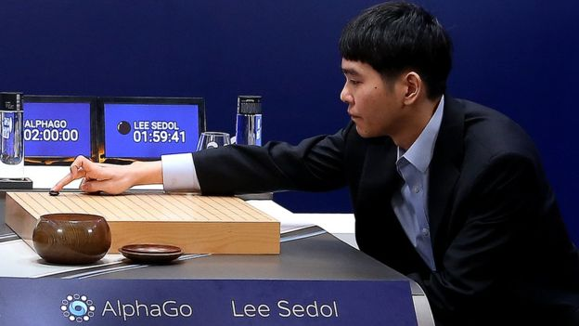
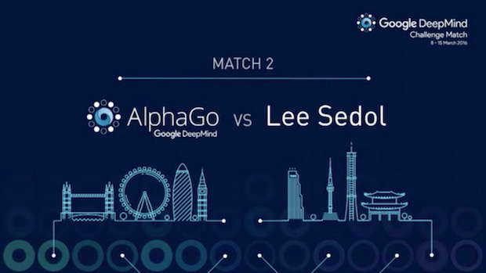
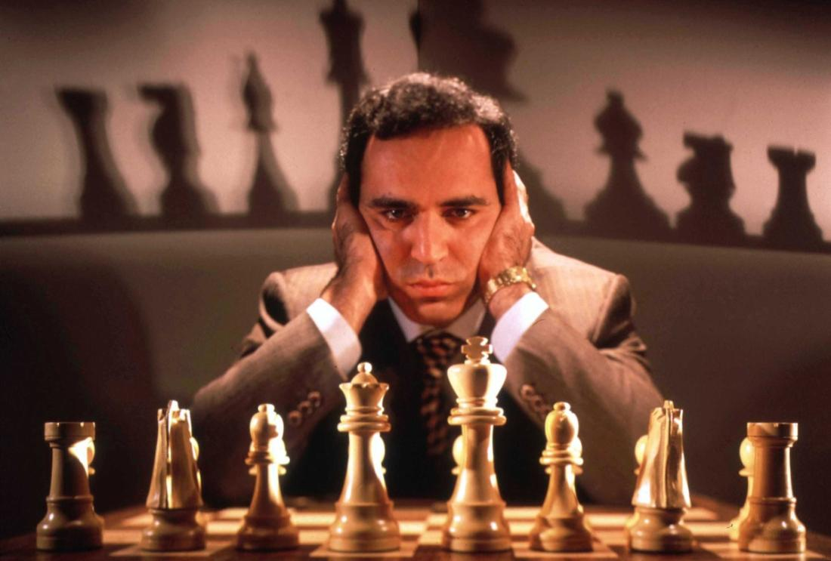
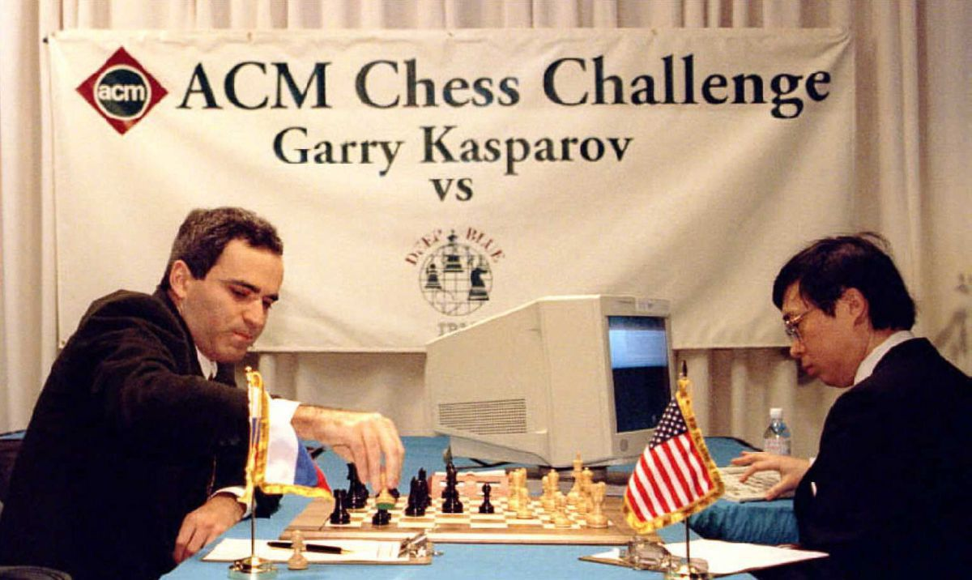

Slide 6
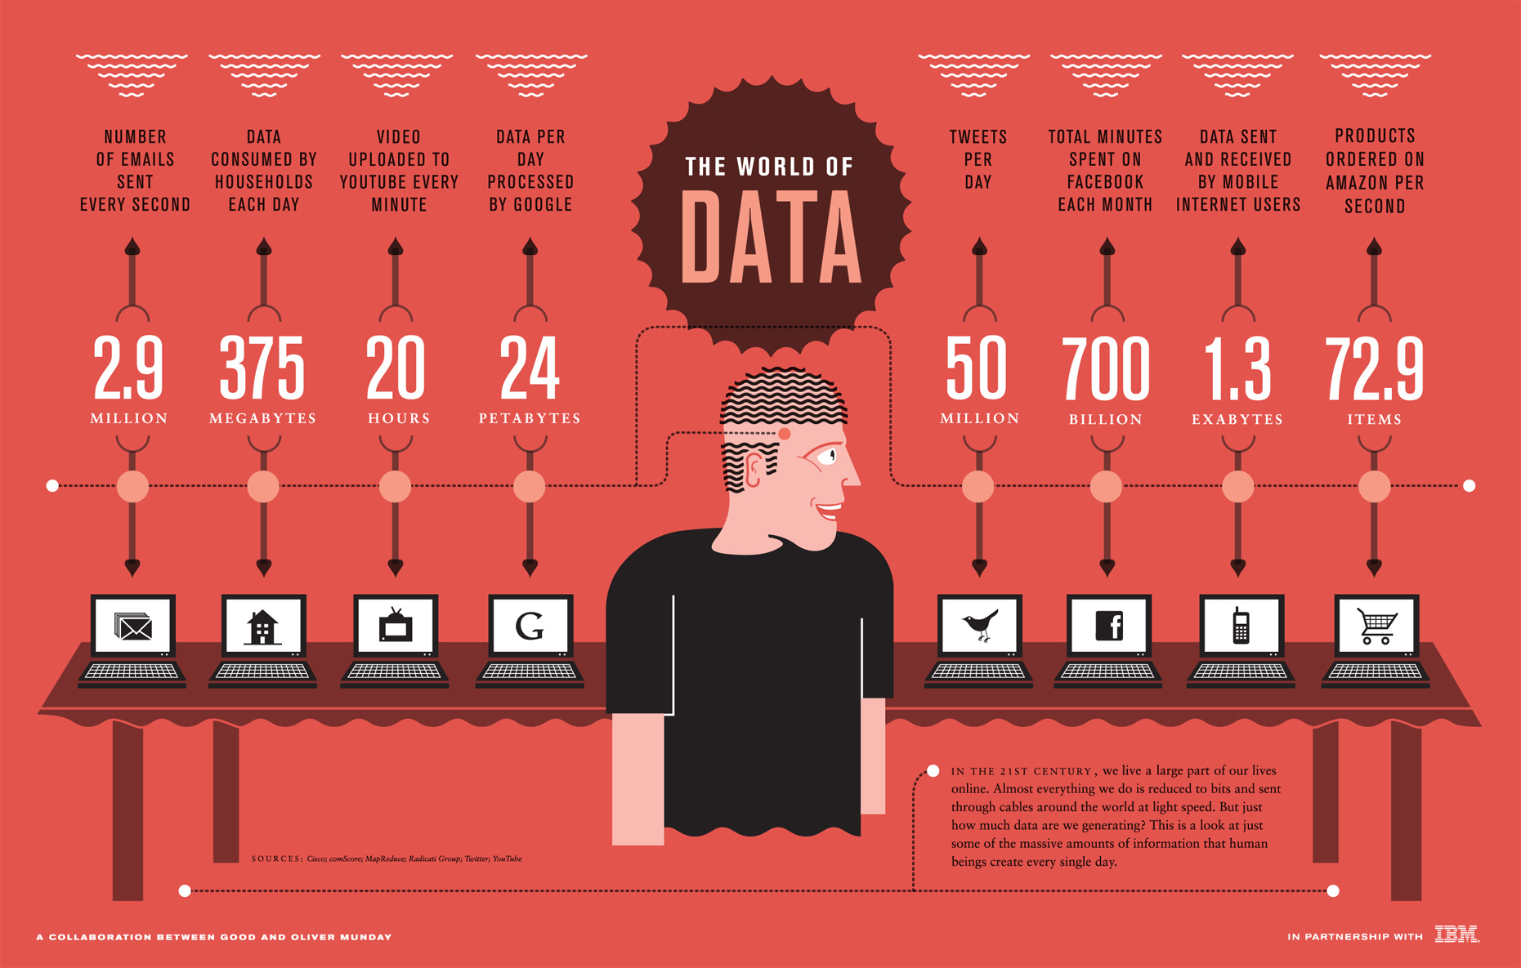
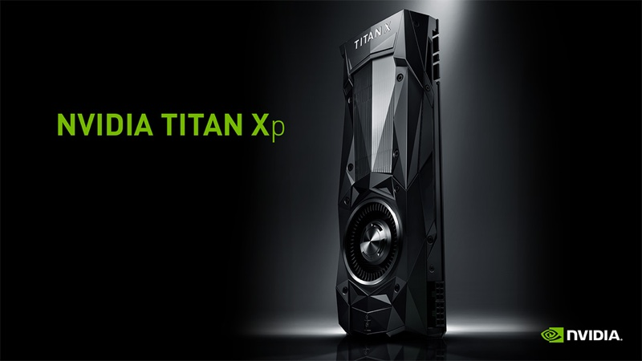
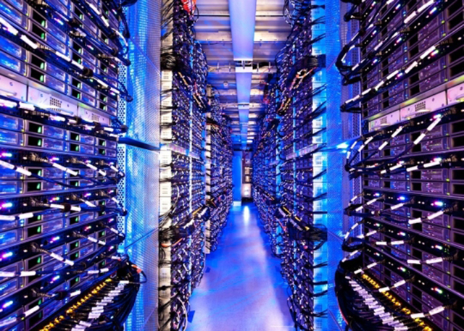
AI isn’t new...
But now there’s more data than ever
Affordable processing power
Inexpensive storage
That equals the models that deliver fast and accurate results

Slide 7
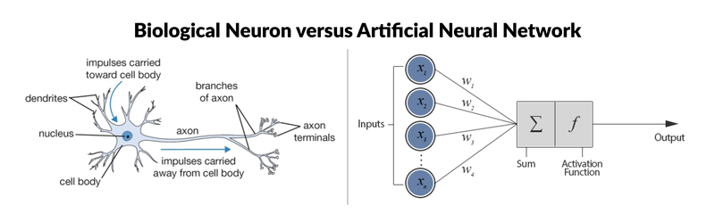
Analogy between biological neuron and artificial neural network

Slide 8
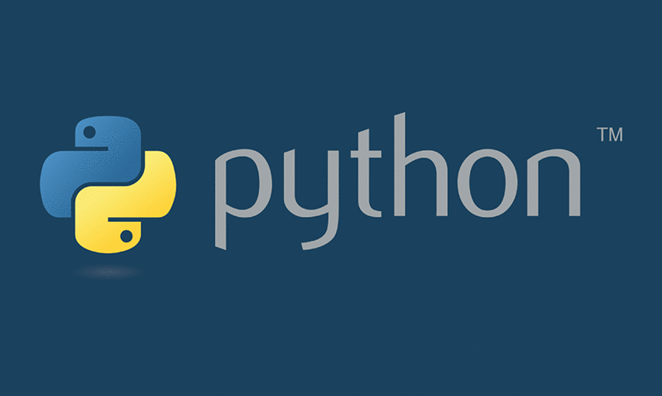




5 best programming languages for AI

Slide 9


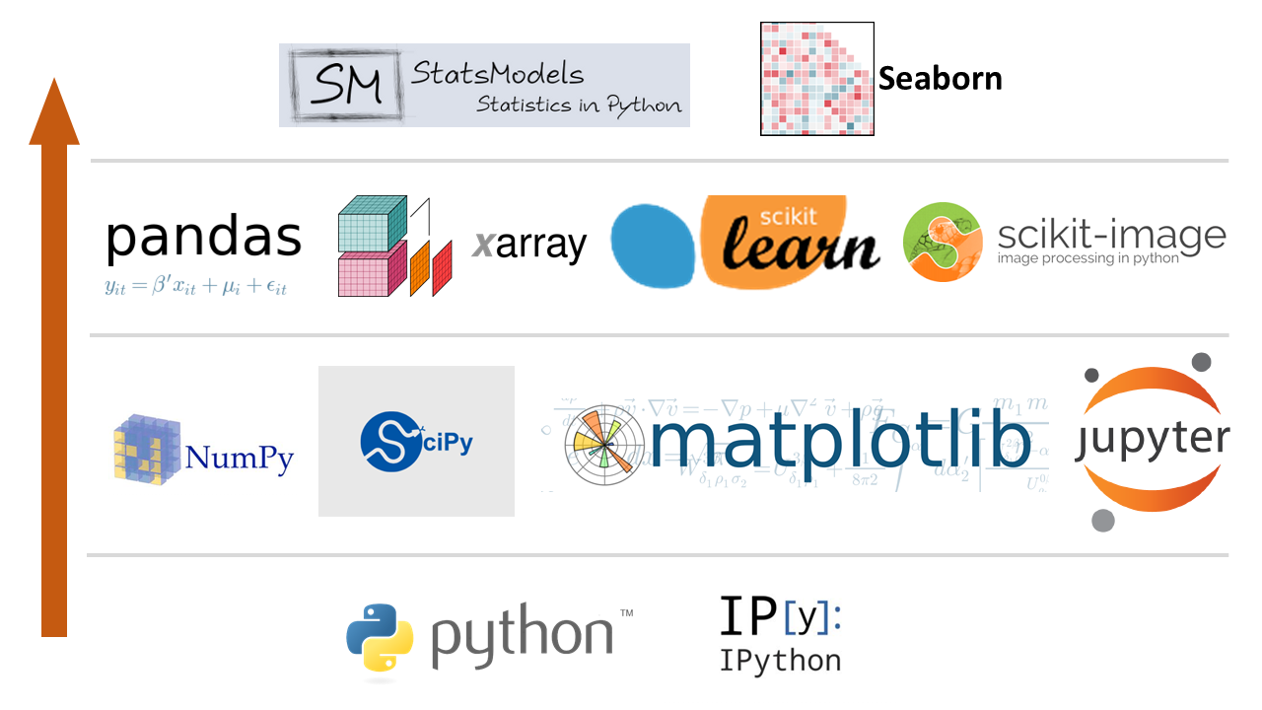





Why I choose python?

Slide 10
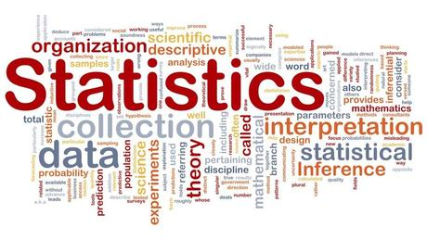
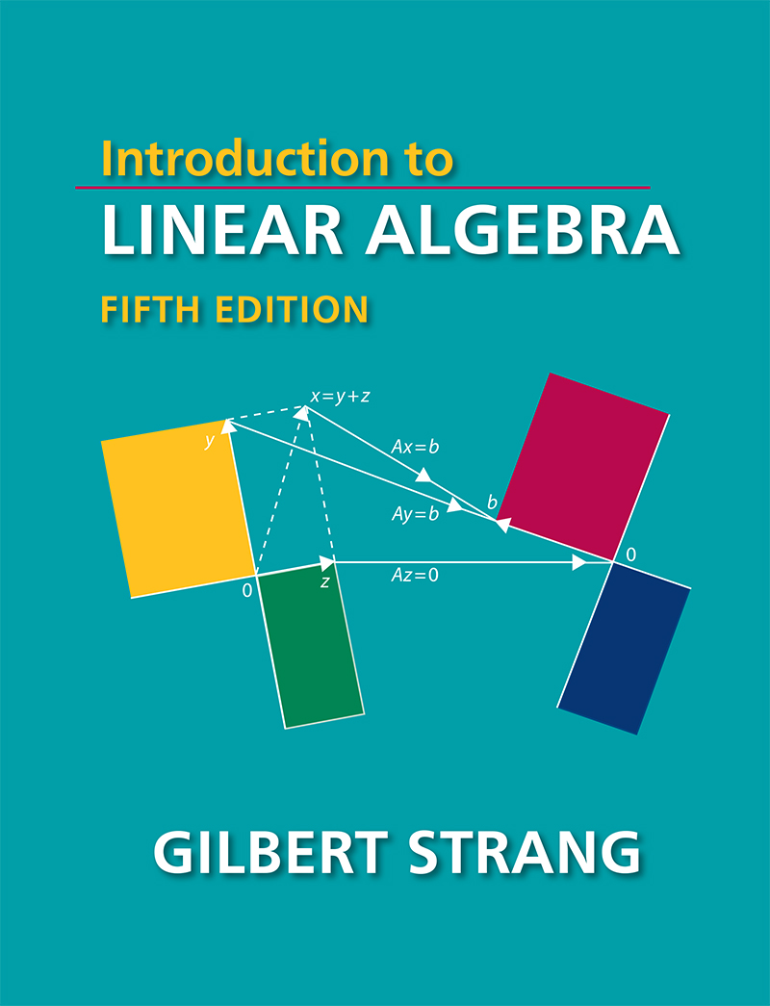

I am new to this ? Can I get into....?
Yes you can!
Prerequisites:
Linear Algebra
Probability and Statistics

Slide 11
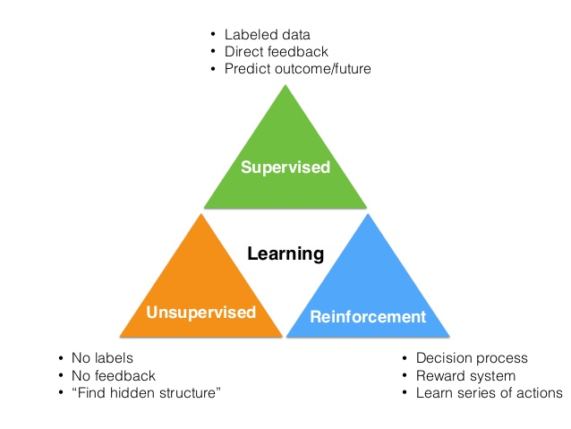
ML can be classified into ...

Slide 12
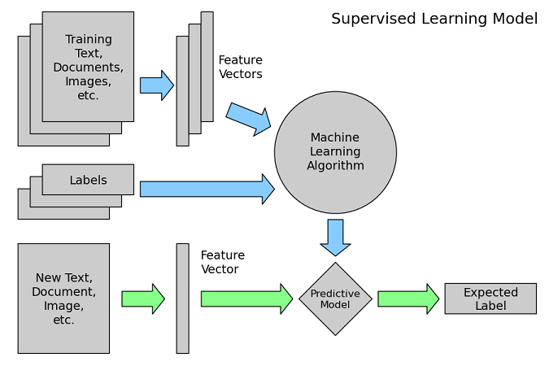
Model Creation flow

Slide 13
Follow this...
Define Problem
Prepare Data
Evaluate Algorithms
Improve Results
Present Results
See example in notes:
Notes:
spam filter example

Slide 14
